Slide 1
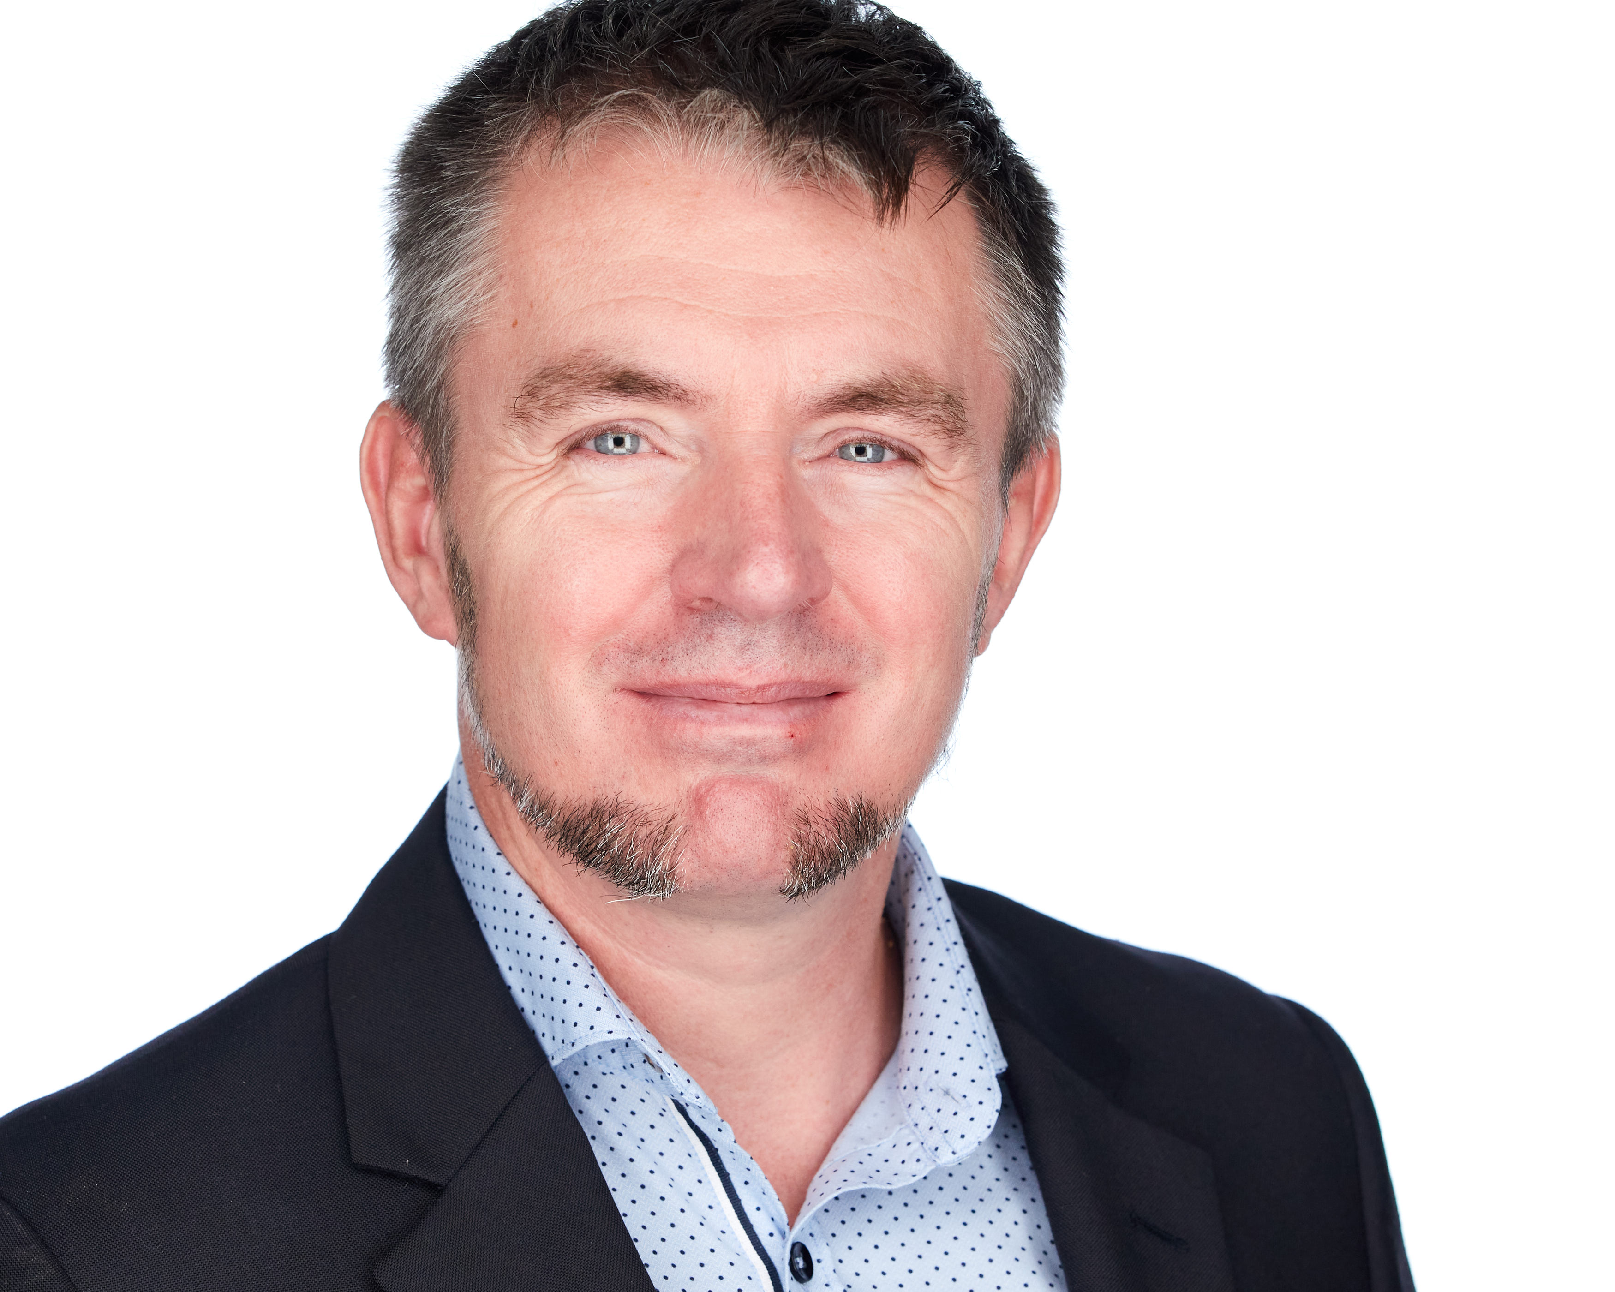





JON-PAUL BOYD
Azure Cloud Solution Architect (AI)
Innovating with AI, ML, and Cloud to deliver transformative Enterprise-scale solutions on Azure. Proven ability to translate complex use cases, organizational architecture, and AI concepts into tangible business value. Demonstrated expertise in technical leadership and democratizing AI knowledge with reference GenAI, MLOps, LLMOps, and roadmap deliverables.
+41 (0)79 952 18 81 jonpaulboyd@gmail.com corticalstack.ai jonpaulboyd Nyon, CH
SUMMARY
30 years of progressive I.T. experience, evolving from software engineering to deep specialization in NLP, GenAI, and ML solutions.
23 LinkedIn recommendations from providing customer-centric expertise to 37 global companies.
Graduated as Master of Intelligent Systems, with distinction, from De Montfort University, Leicester, U.K. (2017-2021).
Extensive experience modelling, cleansing, mining, & visualizing large data collections (0.5M docs), including on cloud platforms.
7 years experience applying machine learning, deep learning, & heuristics to real-world problems including customer feedback, customer churn, breast cancer tumor classification, & manufacturing optimization.
Versatile GenAI skillset spanning text generation for crafting inspirational product content, speech and text-to-video synthesis for personalized chatbots and immersive video experiences, to fine-tuning LLMs for precise customer feedback labelling.
Extensive natural language processing experience, building & evaluating state-of-the-art language models & knowledge bases for highly relevant retrieval of biomedical information, topic modelling, entity recognition, pattern matching, author/paper ranking.
CAREER HIGHLIGHTS
Azure Cloud Solutions Architect (AI)
Nordcloud| Nyon, CH | May 2022 – Present
Driving innovation in GenAI as technical specialist within enterprise GenAI team. Hands-on with entire GenAI product lifecycle, from ideation & feasibility study, to prototyping, stakeholder onboarding, implementation, evaluation, operations, security, & compliance.
Developed an avatar assistant for leading European airline, demoed to Satya Nadella A.I. Tour Berlin October 2024. Inspires customers with destination recommendations resonating with their travel aspirations. Integrates with external systems through function calling for curated destination metadata, image media, flight schedules & prices, accurate weather, flight booking flow.
Developed a GPT-4-powered knowledgebase of destination master data. Implemented LLM-as-a-judge for constitutional oversight of generated content for alignment to safety, accuracy, and bias. Created Streamlit UI for rapid concept & feature validation.
Developed intelligent feedback funneling service with NLP for product classification of customer feedback. Evaluation of different methods including BERT embeddings, tree-based like XGBoost, prompt engineering, GPT causal & sequence classifier models.
Developed a shared summarization service leveraging GPT models and prompt flow. Pre-engineered prompts with summary styles including extractive, abstractive, creative, formal, keyword-based, thematic, and time-series. Acts as a solution multiplier, allowing seamless integration into existing workflows and applications across diverse use cases.
Developed solution for MLOps (Machine Learning Operations) to increase the quality, frequency & efficiency in getting ML model changes to production. Implemented with Azure Machine Learning, Azure DevOps YAML CI/CD pipelines, Azure ML Python & CLI SDK as templates for reuse by data science teams. Prepared & delivered MLOps workshops to data science & engineering teams.
Created an M.L. & A.I., outcome-based roadmap prioritizing needs of data science teams.
Led the M.L. & A.I. services pillar team for a leading airline one data platform. Implemented a Terraform IaC solution for secure Azure Machine Learning PaaS provisioning. Developed least privileges access control concept for Azure ML interaction with data lake. Produced comprehensive educational notebooks showcasing end-to-end machine learning workflows in Azure, using both Python SDK v1 and V2. Produced extensive access control documentation.
Developed & deployed a concept for operational monitoring of a central data platform guided by SRE best practices. Defined SLI/SLOs for collection of the right telemetry to reflect system health & support root cause analysis. Hands-on implementation of Azure log analytics diagnostics collection via Terraform definition of Azure Policy, Azure Monitor alerts, & kusto queries.
Led multiple startup workshops, guiding them through product evolution strategies on Azure. Crafted customized technical architecture blueprints, providing strategic design recommendations to optimize for innovation, scalability, and governance.
Provided tailored A.I. and cloud expertise to participants on the Microsoft Startup Accelerator Program.
HuggingFace contributor, over 50 7B fine-tuned text generation models deployed, with 100K downloads. Best model evaluated 3rd globally. Curated DPO (Direct Preference Optimization) dataset with 50K downloads.
Azure Cloud Solutions Architect (AI)
AC Immune | Lausanne, CH | October 2020 – April 2022
Cleansed, digitised, & enriched 30K research articles for a knowledge base providing neuroscience analysts with sub-second response to queries. Over 10,000x faster than legacy search.
Hands-on, best-practice design, costing, build, configure, deploy, and compliance of Azure services including IaaS, Automation (Python), code-free Logic Apps, Python durable orchestration and activity Function Apps, containerised app services, 3rd party SaaS, storage, key vaults, event grid, and service plans. Azure Monitor (Application Insights) with telemetry logging and metrics for solution monitoring and troubleshooting. Organisation of resources with management and resource groups. Cost management for subscription monitoring and budget alerting. Security with AAD RBAC and MFA, app user authentication with AAD identity provisioning, securing blob access with SAS (Shared Access Signature), system-assigned managed identities and access policies.
Simplified the archiving of new articles with automation, quality controls, and notifications.
Automated tracking & visualization of the highly dynamic COVID-19 vaccine landscape for informed decision making. Clinical trial knowledge aggregation from multiple sources using Airflow & Azure ML platform pipelines, with persistence into an Azure PostegreSQL database for dashboarding & reporting with Power BI & Streamlit.
Prototyped knowledge base supporting time-pressured researchers with more effective information retrieval using large academic literature collection (400K coronavirus papers). Airflow & Azure ML pipelines automate corpus ingestion & cleansing. Heuristics & topic modelling for metadata extraction & document clustering. ElasticSearch for 4.7M paragraph repository. Fine-tuned BERT-based neural network search strategies calibrated to COVID-19 for more relevant results. Streamlit with Python for web front-end.

Slide 2
SAP HANA Technical Architect
Nestle | Vevey, CH | 2014 – 2017
Technical lead, inspiring team implementing groundbreaking analytics solution. Empowered 3000 users with recipe search to answer regulatory compliance, quantity & procurement questions previously impossible. Learned I’m still hungry for technical challenges.
Resolved SAP product shortcomings, developing tool for analytic privileges build & assign, enabling project go-live.
Quantified performance, developing tool measuring query times vs KPIs for user experience/expectation mgmt.
Acquired new skillsets to configure HANA workload management, HALM & HRF, then shared with team.
Formalized SAP HANA development best practices for Nestle application development group.
Executed 5 HANA major upgrades & migration of analytics sidecar to embedded NetWeaver/HANA dual stack.
SAP HANA Technical Architect
Bluefin Solutions | London, UK | 2014
Helped BAT realise Gartner’s Logical Data Warehouse concept by implementing HANA SDA for data federation of London & Sydney databases. Learned trust won on transparency & keeping delivery promises goes a long way.
Developed new P&L, achieving sub-second performance (legacy 2m10s), SAP Fiori KPI dashboard with item drill-down.
EDUCATION
Masters Intelligent Systems
De Montfort University | UK | 2017 – 2020
Discovered why stronger partnerships should exist between enterprise and academia.
Masters Thesis Project (90%) Addressed 2 objectives: Support decision-making with timely & highly visual summarisation of the COVID-19 vaccine development landscape. Support time-pressured researchers with effective information retrieval. Designed, developed & deployed an Azure cloud-hosted knowledge base of coronavirus research & vaccine clinical trial information. Automated orchestration of high-volume structured & unstructured data aggregation, cleansing, classification, metadata creation & persistence. Automated state-of-the-art BERT-transformer model calibration to complex COVID-19 semantics & embedding of paragraph text sequences from 0.5M documents into ElasticSearch. Exploration via mobile, secure app using Streamlit framework. Search results outperformed PubMedCentral as evaluated by a medical expert.
Applied Computational Intelligence (88%) Predicting customer behaviour with tree-based machine learning classifiers. Extensive Python with data profiling & preparation, unsupervised & supervised machine learning, overfitting protection, hyperparameter tuning, model scoring, evaluation & selection.
A.I. Programming (80%) NLP Python NLTK context-free grammars for natural language to SQL database query.
Data Mining (80%) Data analysis & machine learning to predict risk indicators for cardiovascular disease.
Neural Networks (80%) Evaluation of biomass & classification of network activity (intrusion, attack, normal).
Fuzzy Logic (94%) Classifying breast cancer tumours with fuzzy inference, outperforming neural networks.
Research Methods (96%) PhD proposal for augmented analytics.
Mobile Robots (97%) Virtual search & rescue robot controlled via Python, implementing obstacle avoidance, sensor data fusion, environment mapping, precision navigation, victim location.
Computational Intelligence Optimization (100%) Design & build of Python hyper-heuristic optimization platform to solve scheduling optimisation. 5 nature-inspired metaheuristic algorithms implemented. Hyper-heuristics dynamically switch low-level metaheuristics to deterministically use the most appropriate algorithm according to current problem state, or select one stochastically.
TOOLS
Machine Learning & Deep Learning: regression, decision tree, random forest, boosting, classification, clustering, neural networks
Natural Language Processing: transformer architecture, prompt engineering, in-context n-shot learning, inference parameter tuning, LLM pre-training & domain fine-tuning, custom dataset generation (e.g., T5 seq-2-seq), RLHF (Reinforcement Learning from Human Feedback), vector DBs for knowledge bases & information retrieval, semantic similarity search (symmetric & asymmetric), lexical TF-IDF search, search strategies (re-ranking, hybrid fusion), embedding approaches, LLM evaluation, Generative A.I. lifecycle
Programming & scripting: Python, LangChain, Pandas, Numpy, spaCY, NLTK, Scikit-Learn, Keras, Pytorch, SQL, HTML/CSS3, SAP ABAP
Databases: MS SQL, PostegreSQL, MySQL, MongoDB, ElasticSearch, Azure Cognitive Search, Pinecone, Weaviate, SAP HANA
Azure Cloud: OpenAI, AI Services including text & speech, AI Search, Prompt Flow, ML, Stream Analytics, automation, scalable IaaS, serverless & containerized compute, security, networking
Frontend: Streamlit, HTML, JavaScript, CSS
Other: Docker, Linux, GitHub, Terraform, Apache Airflow
PRAISE
“Tech savvy, experienced, meticulous, dependable, ingenious & eager to learn more”
Rudi Dutli, Principal, Infosys Lodestone
“Builds comprehensive understanding of architectures involved, educating & inspiring teams & co-workers in the process. A real flair for challenging, on-the-edge development”
Trond Stroemme, Team Lead, SAP App Expertise Centre, Nestle
“An expert in his domain, a great team player. His focus on results with optimal quality is outstanding”
Norbert Rignall, Master Data Solution Architect, Nestle
AWARDS
Microsoft Azure Certified (Architect Expert, DevOps Engineer Expert, A.I. Engineer Associate, Data Scientist Associate, Administrator Associate)
DeepLearning.AI Generative AI with Large Language Models, Udemy Develop LLM powered applications with LangChain
AWS Certified (Cloud Practitioner, Machine Learning Specialty)
Hashicorp Certified Terraform Associate

